Slide 1
Group 11
Which systems can manage free and open storage without the help of any centralized party?

Slide 2
Introduction -
Today, several important Internet-related services, including domain name resolution, e-mail, social networks, and online storage, are centralized and/or under the authority of lobbies, huge corporations, or governments. Moreover, the architectural constraints of centralized systems (e.g. single point of failure components), even when they have high redundancy, make these systems vulnerable to Denial of Service (DoS) attacks, data misuse and exfiltration attacks.
In this context, users are forced to follow a set of rules –sometimes unclear– to use such systems.

Slide 3
Continue
To overcome that situation and paired with the recent hype of Distributed Ledger Technologies (DLTs), decentralized architectures are gaining momentum. Nevertheless, decentralized architectures are not novel. The benefits of such architectures were explored in the early ‘60s to eliminate single point of failure issues as well as to increase the robustness and redundancy of the systems.

Slide 4
Solution Decentralized Systems
Decentralized System
Intrduction :
With decentralized storage, data is encrypted and stored across multiple locations, or nodes, that are run by individuals or organizations that share their extra disk space for a fee. Only the data's owner holds the private encryption key; storage providers cannot access the data. In many cases, the files are also sharded and spread across multiple locations, providing yet another layer of storage security.
Decentralized data storage products often use blockchain to track storage transactions. Blockchain is a distributed ledger technology that can automatically synchronize and validate storage transactions across distributed nodes. The blockchain ledger might record shard hashes, data locations, leasing costs or other transaction-specific information. Blockchain can also match users looking for storage with hosts that offer it.

Slide 5
What are the benefits of decentralized storage networks?
Decentralized storage networks can deliver many benefits. When an organization uses a decentralized network primarily for storage, the main benefit is cost. Decentralized storage networks act as a brokerage service between those who need storage and those who have extra capacity that they are willing to lease. As such, that storage tends to be inexpensive.
In many cases, decentralized storage networks are based on blockchain or similar technologies and deliver benefits such as data immutability, enhanced privacy and better overall security. Decentralized networks are resilient because the storage does not have a single point of failure.

Slide 6
Cont
In many cases, decentralized storage networks are based on blockchain or similar technologies and deliver benefits such as data immutability, enhanced privacy and better overall security. Decentralized networks are resilient because the storage does not have a single point of failure.
Example : Arweave, Bittorrent
With P2P sharing, files aren’t stored in a single place. Instead, they’re distributed across a network of many nodes. Each file, or piece of a file, is given a unique cryptographic hash. This means all versions are tracked across the network. When a user requests the data, the network finds the nodes holding a perfect match to the unique hash or hashes.
Using hash addresses distributed across multiple nodes means the content is immutable yet permanently available. It doesn’t matter if a single node goes down because other nodes may instantly deliver a duplicate.

Slide 7
Functionality
General Users
Search and Download Report
Upload Report and earn coins
Be a community member with coins
Community Members
All access of a General user
Request Report
Share report within groups
Upvote, Downvote, and make comments

Slide 8
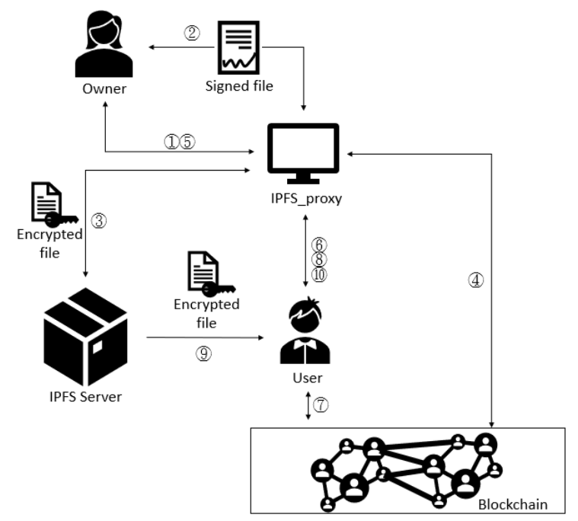
Overview of the system

Slide 9
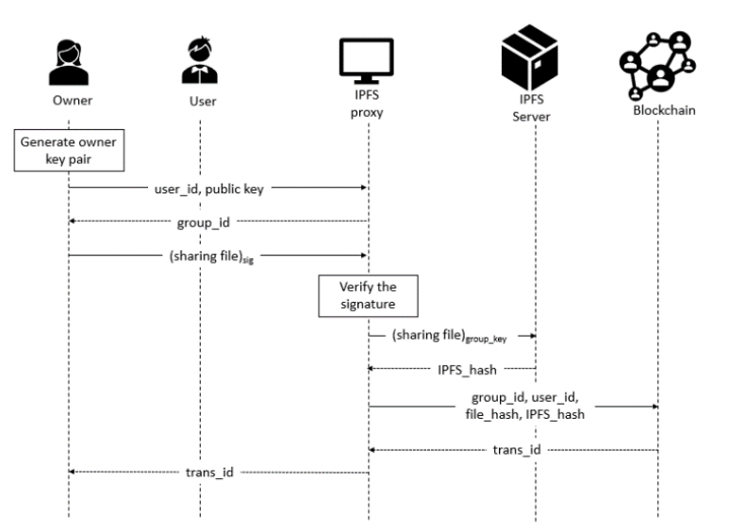
File uploading process

Slide 10
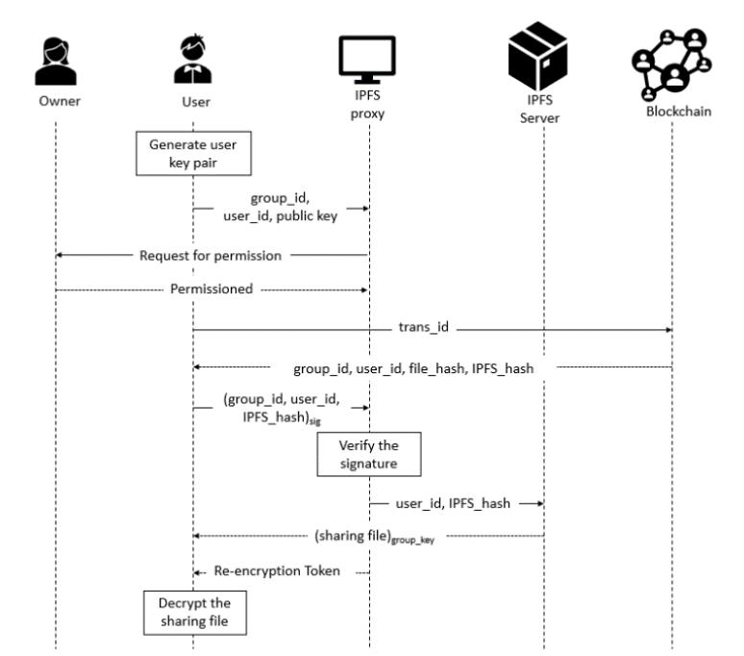
File downloading process

Slide 11
References
Huang, H.S., Chang, T.S. and Wu, J.Y., 2020, July. A secure file sharing system based on IPFS and blockchain. In Proceedings of the 2020 2nd International Electronics Communication Conference (pp. 96-100).
Ford, B., Srisuresh, P. and Kegel, D., 2005, April. Peer-to-Peer Communication Across Network Address Translators. In USENIX Annual Technical Conference, General Track (pp. 179-192).
Preneel, B., 1994. Cryptographic hash functions. European Transactions on Telecommunications, 5(4), pp.431-448.
Naz, M., Al-zahrani, F.A., Khalid, R., Javaid, N., Qamar, A.M., Afzal, M.K. and Shafiq, M., 2019. A secure data sharing platform using blockchain and interplanetary file system. Sustainability, 11(24), p.7054.

